Slide 1
Peanut Weed Control Update - 2017
Eric P. Prostko, Ph.D.
Professor and Extension Weed Specialist
Department of Crop & Soil Sciences

Slide 2
2016 Peanut Weed Control Research
PE-08B-16
June 22, 2016
56 DAP

Slide 3
2016 Peanut Weed Control Research
PE-08B-16
August 9, 2016
104 DAP

Slide 4
Somewhere in SW Georgia on July 8, 2016

Slide 5
Peanut Weed Control - 2016
Prowl H₂0 @ 32 oz/A – PRE
Valor @ 3 oz/A – PRE
Strongarm @ 0.225 oz/A – PRE
Cadre @ 4 oz/A – 41 DAP
Dual Magnum @ 16 oz/A – 41 DAP
2,4-DB @ 16 oz/A – 41 DAP
$46.00/A
PE-12B-16
July 8
66 DAP
6313 lbs/A

Slide 6
Peanut Weed Control - 2016
Prowl H₂0 @ 32 oz/A – PRE
Gramoxone @ 12 oz/A – 11 DAP
Storm @ 16 oz/A – 11 DAP
Dual Magnum @ 16 oz/A – EPOST
Cadre @ 4 oz/A – 41 DAP
Dual Magnum @ 16 oz/A – 41 DAP
2,4-DB @ 16 oz/A – 41 DAP
$43.00/A
PE-12B-16
July 8
66 DAP
6041 lbs/A

Slide 7
Top Herbicides Applied to Peanut (% of Planted Acres)
NASS
Chemical Use Survey
2013

Slide 8
Prowl vs. Sonalan Research Summary
Year | Source | State | Results
1993 | Peanut Science 20:126-128 | TX | 1) No difference in yield. 2) Grades 1.1% lower with Prowl.
2002 | Peanut Science 29:141-145 | GA | No difference in Texas panicum control. No difference in yield.
2003 | Peanut Science 30:34-37 | TX | 1) No difference in yield or grade.
2011 | Peanut Science 38:57-60 | GA | 1) 8.6% less yield with Sonalan***
2016 Prices/gal: Sonalan 3EC = $42; Prowl 3.3EC = $27; Prowl H₂O 3.8ASC= $35
Cost for 1 qt/A: Sonalan 3EC = $10.50; Prowl 3.3EC = $6.75; Prowl H₂O 3.8ASC= $8.75
LB AI for 1 qt/A : Sonalan 3EC = 0.75; Prowl 3.3EC = 0.83; Prowl H₂0 ASC= 0.95

Slide 9
Starting Clean!!!!!
4-5’ tall AMAPA
Mowed
Disked
Rototilled 2X
Photo taken
17 Days later

Slide 10
Palmer Amaranth Height
Low = 1.5”
High = 9.5”
Average = 5.3”
9/19 (47%) taller than avg.

Slide 11
Flumioxazin

Slide 12
Panther 4SC Mixing Order (liquid flumioxazin)

Slide 13
Not Rowel FX!!!!!!!!! Valor + Classic

Slide 14
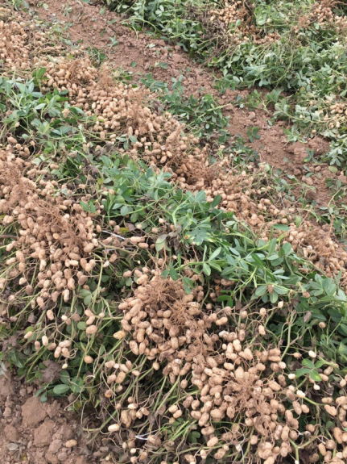
Valor In-Furrow Oh Sxxt!
Panther 4SC
3 oz/A
INFR
Admire Pro
INFR
Variety: GA-06G
Planting Date: May 17, 2016
Pictures: July 8, 2016 and at harvest
Photos: Dr. Jason Sarver, Mississippi State University

Slide 15
ELE-MAX ENC
Helena
11-8-5 + B, Fe, Mn, Cu, Zn, Co, Mo
1 qt/A = $4.50
Does it act as a peanut safener?
Does it improve weed peanut control?
Does it improve peanut yields?

Slide 16
Influence of ENC @ 32 oz/A on Peanut Leaf Burn - 3 DAT
LSD (0.10) = 4
CV = 14.27
(8 oz/A)
(8 oz/A + 16 oz/A)
PE-20-16
May 19
(12 oz/A + 16 oz/A + 16 oz/A)

Slide 17
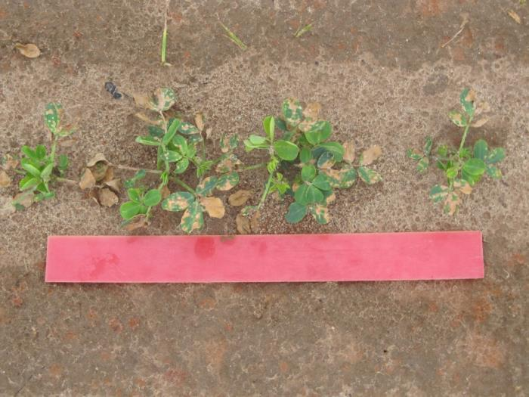
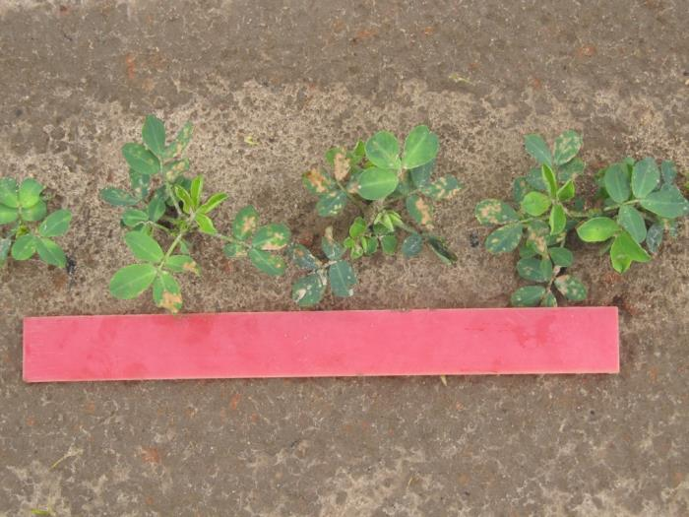
Gramoxone 2SL @ 8 oz/A + Dual Magnum 7.64EC @ 16 oz/A – 3 DAT
- ENC
+ ENC @ 32 oz/A

Slide 18
The Influence of Ele-Max ENC on Peanut Yield – 2016*
PE-20-16
GA-06G
P = 0.2435
CV = 11.7
*Averaged over 4 herbicide treatments.

Slide 19
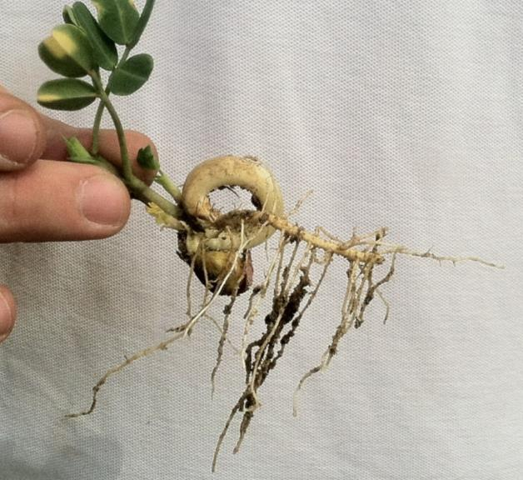
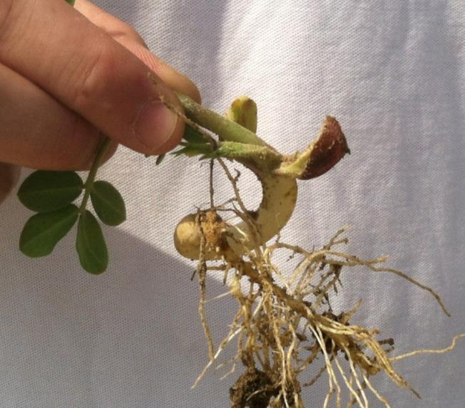
J-Rooting Peanuts – No Herbicides Applied GA-06G, Planted May 5, 2014, Pictures May 20

Slide 20
Dual Magnum 7.62EC
42 oz/A - PRE
NTC
34 DAT

Slide 21
Does Dual Magnum 7.62EC @ 42 oz/A (2X) Applied PRE Cause Peanut J-Rooting??
P = 0.1660
CV = 13.02
34 DAT
PE-61-16

Slide 22
Does Dual Magnum 7.62EC @ 42 oz/A (2X) Applied PRE Cause Peanut Yield Loss?
PE-10-16
P = 0.2025
CV = 8.37

Slide 23
Sinbar Injury

Slide 24
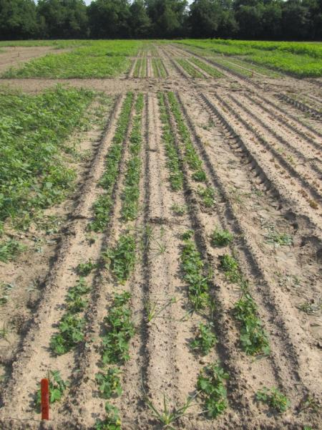
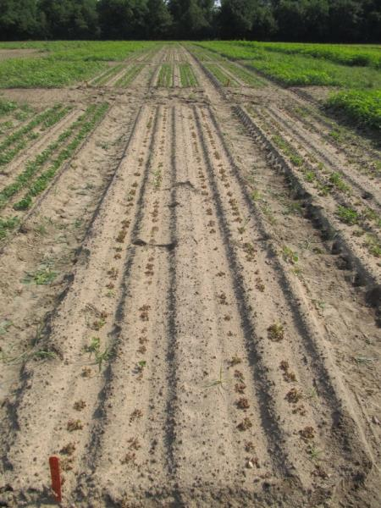
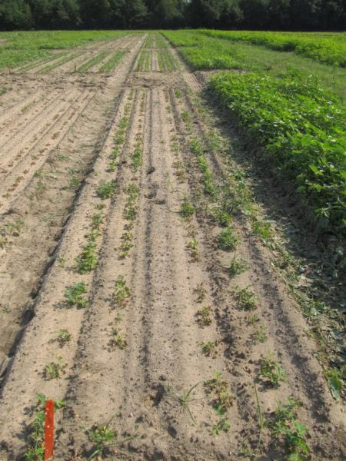
Peanut (GA-06G) Response to Sinbar 80WG Applied PRE
NTC
Sinbar 80WG
4 oz/A
Sinbar 80WG
2 oz/A
PE-21-16
21 DAT

Slide 25
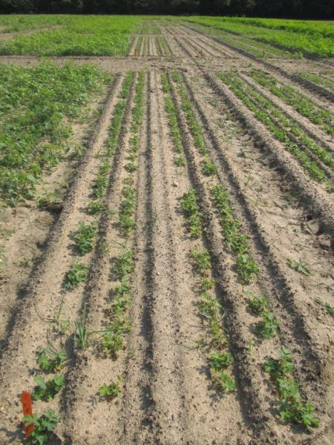
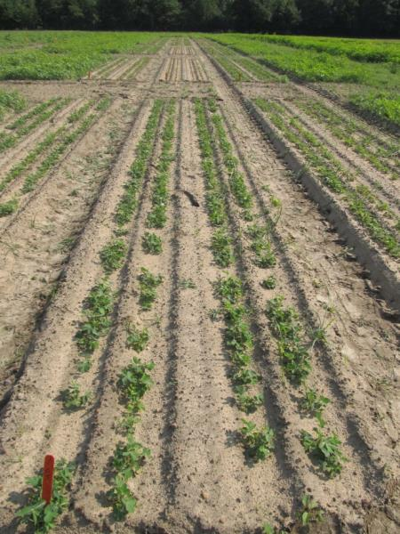
Peanut (GA-06G) Response to Sinbar 80WG Applied PRE
NTC
Sinbar 80WG
1 oz/A
Sinbar 80WG
0.5 oz/A
PE-21-16
21 DAT

Slide 26
Table 1. Peanut stand, plant height, and yield reductions caused by preemergence applications of terbacil, 2016.
Terbacil Rate (lb ai/A) | Peanut Responseª
 | Stand Reduction (%)^{b} | Height Reduction (%)^{c} | Yield Reduction (%)
0.0 | 0 c | 0 c | 0 d
0.025 | 0 c | 2 c | 5 d
0.05 | 8 c | 7 c | 17 c
0.10 | 71 b | 27 b | 68 b
0.20 | 100 a | 100 a | 100 a
ªMeans in the same column with the same letter are not significantly different
according to DMRT (P=0.10).
^{b}56 DAP
^{c}120 DAP

Slide 27
Peanuts/2,4-D/Dicamba
How much?
Vapor Drift = 1/1000thX?
Particle Drift = 1/100thX?
When?
Tank-contamination
Is dicamba always worse than 2,4-D?

Slide 28
Peanut (GA-12Y) Response to Enlist Duo 3.3SL (glyphosate + 2,4-D choline) Applied at Various Times @ 56 oz/A
PE-05-16
August 12
107 DAP

Slide 29
Peanut (GA-12Y) Yield Losses (%) Caused by Enlist Duo 3.3SL - 2016
Rate/A² | Time of Application (DAP¹)
 | 15 | 30 | 60 | 90
1X (56 oz/A) | 45 | 61 | 64 | 56
0.1X (5.6 oz/A) | 12 | 11 | 7 | 3
0.01X (0.56 oz/A) | 12 | 5 | 5 | 5
¹DAP = days after planting.
²56 oz/A = 0.7 lb ae 2,4-D + 0.74 lb ae glyphosate; 5.6 oz/A =
0.07 lb ae 2,4-D + 0.074 lb ae of glyphosate; 0.56 oz/A= 0.007 lb ae
2,4-D + 0.0074 lb ae glyphosate.
PE-05-16
LSD 0.10 = 8
CV = 38

Slide 30
Peanut (GA-06G) Response to Engenia 5SL (dicamba) Applied at Various Times @ 12.8 oz/A
15 DAP
30 DAP
60 DAP
90 DAP
PE-04-16
August 12
107 DAP

Slide 31
Peanut (GA-06G) Yield Losses (%) Caused by Engenia 5SL - 2016
Rate/A | Time of Application (DAP¹)
 | 15 | 30 | 60 | 90
1X (12.8 oz/A) | 87 | 93 | 87 | 38
0.1X (1.28 oz/A) | 16 | 19 | 23 | 3
0.01X (0.128 oz/A) | 6 | 8 | 3 | 0
¹DAP = days after planting.
PE-04-16
LSD 0.10 = 7
CV = 23

Slide 32
Peanut Yield Loss Caused By Simulated Drift Rates (1X) - 2016
Engenia = 12.8 oz/A
Enlist Duo = 56 oz/A

Slide 33
Peanut Yield Loss Caused By Simulated Drift Rates (1/10X) - 2016
Engenia = 1.28 oz/A
Enlist Duo = 5.6 oz/A

Slide 34
Peanut Yield Loss Caused By Simulated Drift Rates (1/100X) - 2016
Engenia = 0.128 oz/A
Enlist Duo = 0.56 oz/A

Slide 35
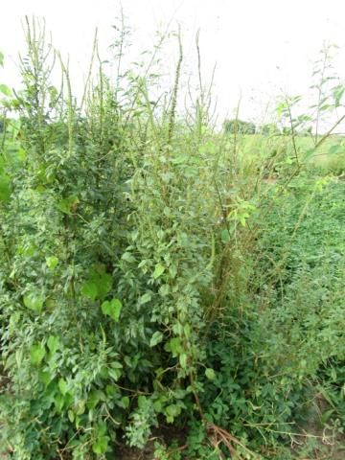
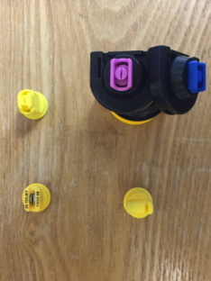
2016 Nozzle Research Prowl + Valor + Strongarm (PRE) fb Cadre + Dual Magnum + 2,4-DB (45 DAP)
11002DG
11002AIXR
NTC
TTI02
TADF02-D
PE-12-16
August 10
107 DAP

Slide 36
New Labels 2017?
Zidua 85WG = pyroxasulfone (BASF)
Anthem Flex 4SE = Zidua + Aim (FMC)
3.733 lbs Zidua + 0.267 lbs Aim
POST
With Gramoxone and/or Cadre
UGA will not support PRE use
Why? No 2X safety margin
What about Brake?

Slide 37
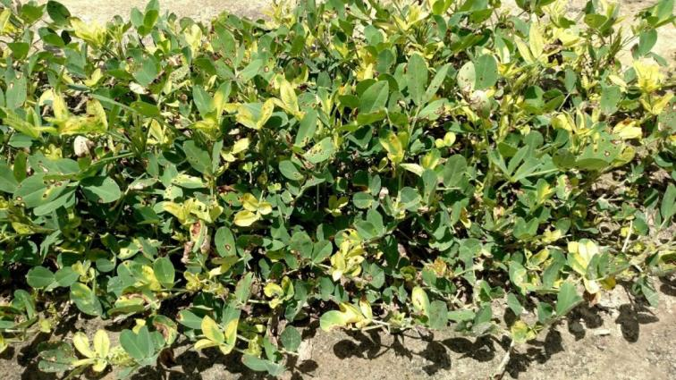
Glyphosate/Peanuts Again in 2016
Pierce County
Decatur County

Slide 38
What do the top Georgia peanut growers do? 2015 Georgia Peanut Achievement Club Winners
12 growers
6426 lb/A average yield
GA State Avg. = 4470 lb/A
12/12 - irrigated
9/12 - bottom plow
12/12 - twin rows
Herbicides
10/12 - Sonalan
10/12 - Valor
2/12 - Dual
9/12 - Cadre
6/12 - 2,4-DB
2/12 - Prowl
2/12 - Strongarm

Slide 39
Webster County – Sept 4, 2015
2013-2016
Dryland
peanuts
18 oz of Cadre over 4 years

Slide 40
UGA-Tifton – December 6, 2016

Slide 41
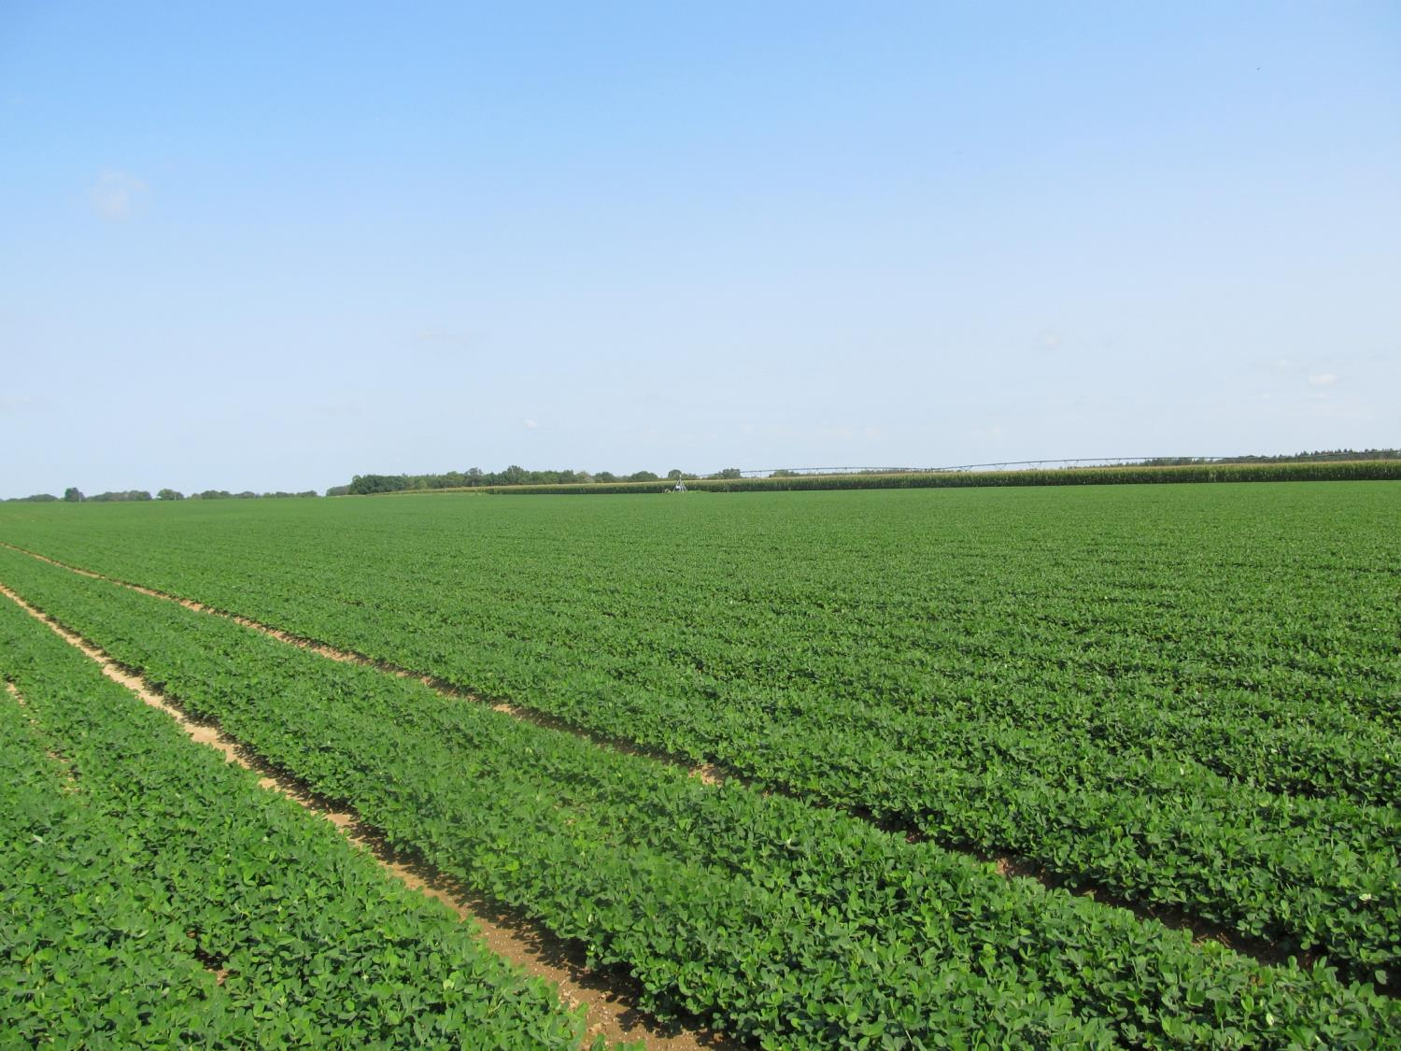
Questions?
eprostko@uga.edu
www.gaweed.com

